Slide 1


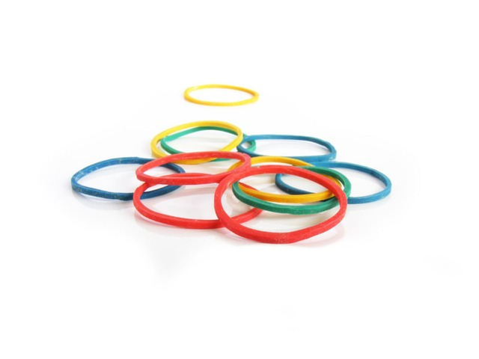



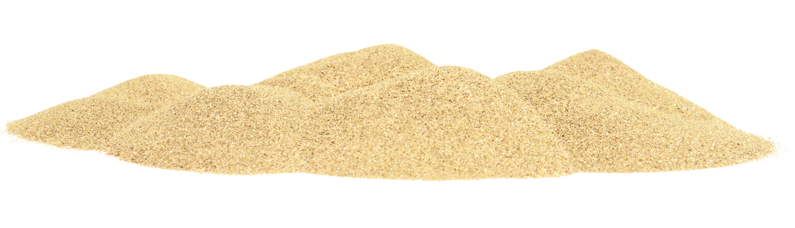
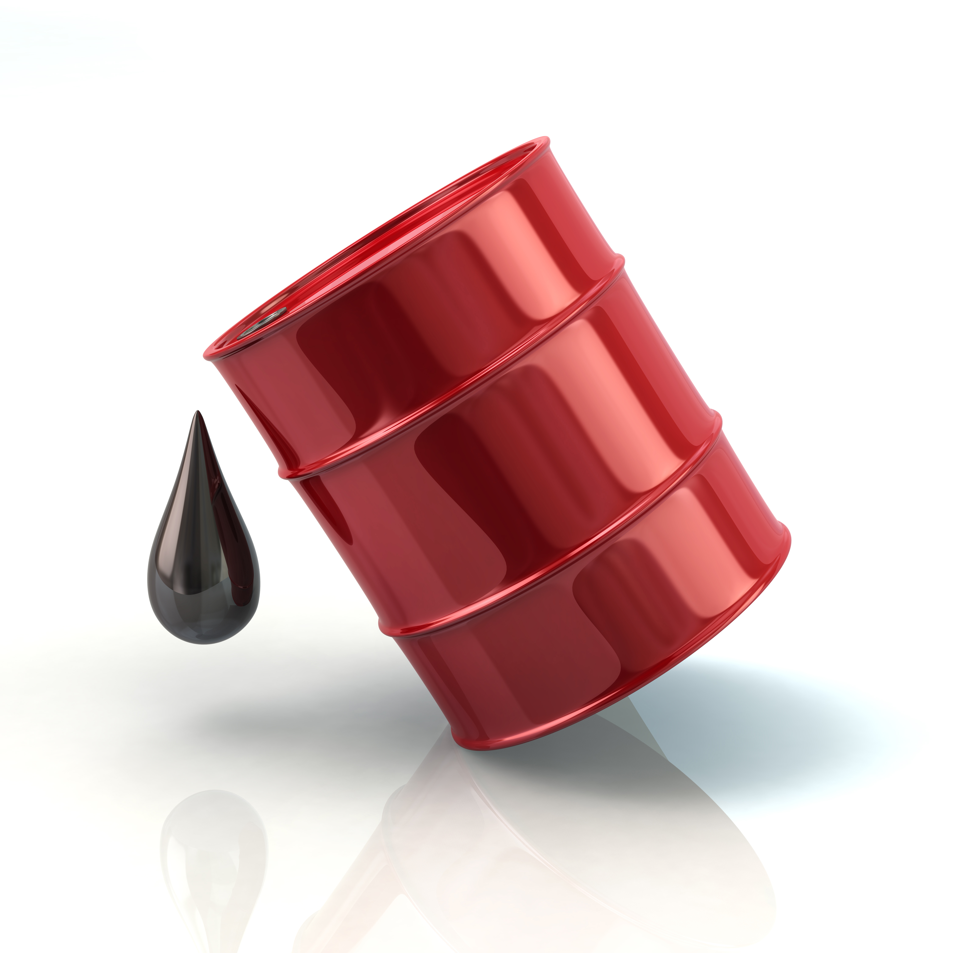
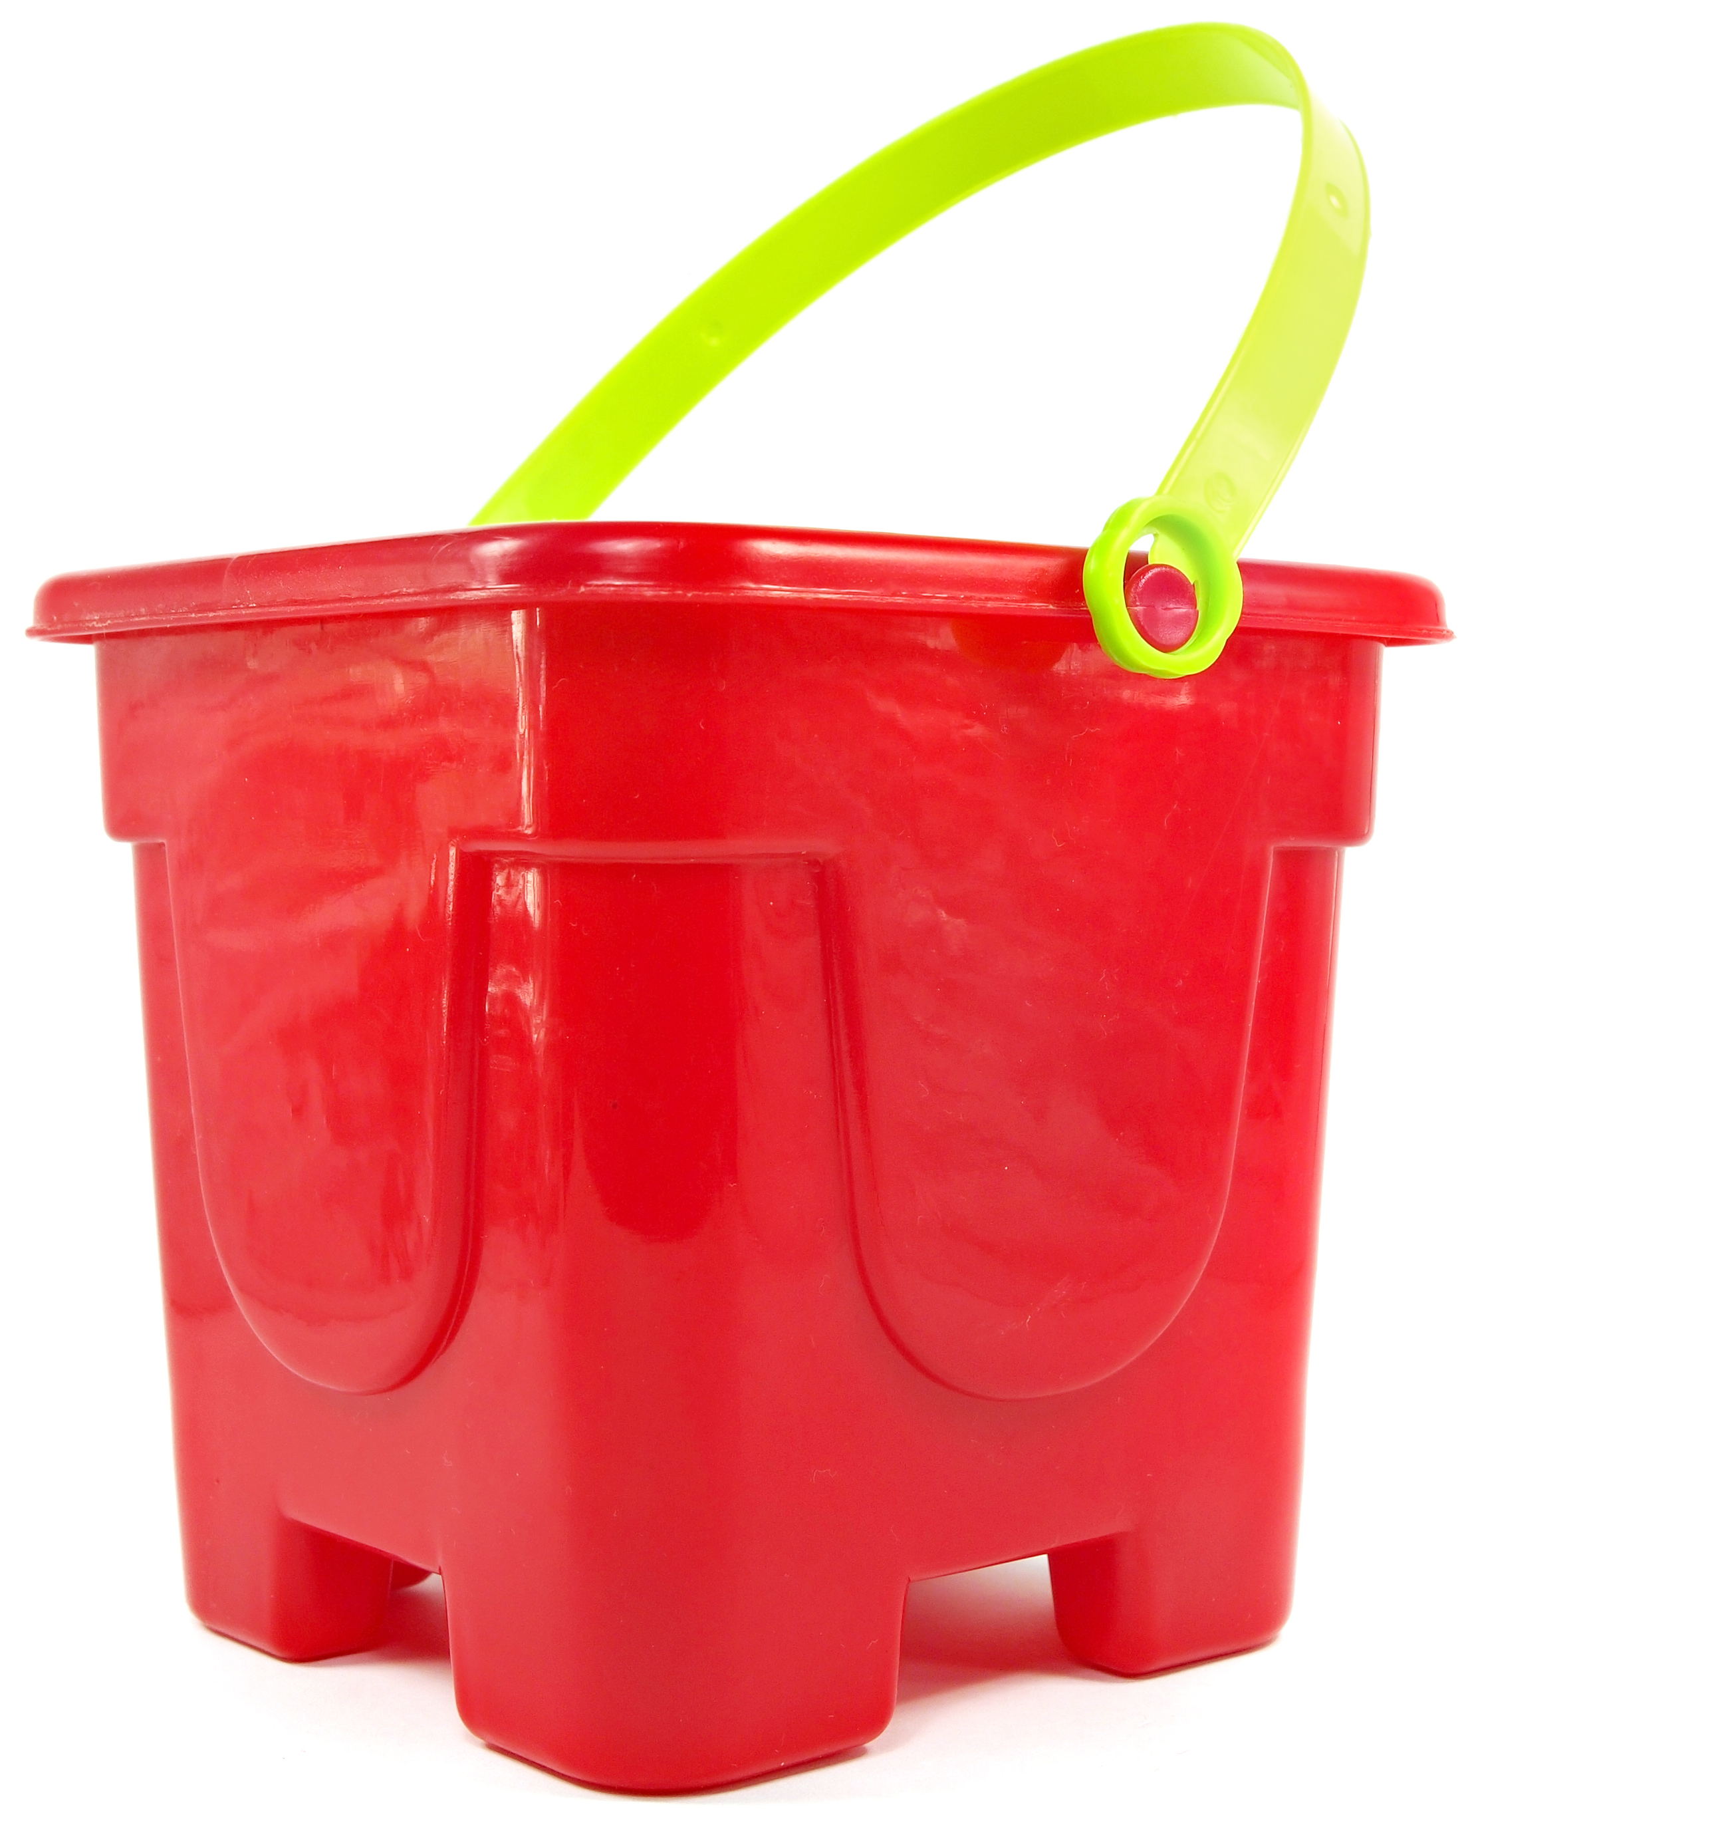


Natural resources which are used in every day life include: water, air, trees and plants, and cotton.
Knowledge Organiser
Properties of Materials
Some insulating materials found in our houses include fibre glass loft insulation, cavity wall filler and double-glazed windows.
ROCKET WORDS Learn these words and their definitions.
Key Word | Definition
comparative test | Undertaking a test with a controlled variable to help answer questions.
elasticity | The ability of a material to resume its normal shape after being stretched or compressed.
plasticity | The ability for a material to be easily shaped or moulded.
crude oil | A natural oil formed by carbon deposits and organic materials.
perforate | To pierce or puncture something.
extraction | To remove something from its natural setting.
thermal conductivity | The ability of a material or substance to conduct or transfer heat.
inexhaustible | Something unable to be used completely because there’s too much of it to be all used up.
Ways to test materials
Lesson Sequence
Hardness
How resistant a material is to scratching and pressure.
Hard materials: hardwood, metal, plastics
Strength
The amount of force needed to break a material.
Strong materials: many metals and woods.
1
Learn how to compare and group everyday materials
2
Compare the properties and uses of different materials
3
Make the perfect sandcastle
4
5
6
Explore materials which can be derived from crude oil; explain the importance or carbon compounds in our lives.
Explore extracting useful substances from natural resources
Explore the thermal conductivity of materials to improve energy efficiency In buildings or other systems.
Elasticity
Ability of a material to turn to its original shape after the force is removed
Elastic materials: rubber bands, metal coil springs
Plasticity
Ability to retain the new shape when the force is removed.
Example materials: plasticine, clay.
Absorbency
Ability of a material to soak up liquid.
Absorbent materials: sponge, cotton wool, towel.
Waterproof
Resistant and repellent to a liquid
Waterproof materials:
Many rubbers and plastics
crude oil
Formed by the heating and compression of organic materials (plants, animals) over millions of years - such as algae or zooplankton.
Extracted by oil companies by drilling into the seabed and brining it up through intense pressure, and stored in containers.
Used to help make many plastic products and everyday items, meaning it is useful. However, can also be bad for environment.
Building a perfect sandcastle…

